Slide 1
Analytical Instruments at the CDPHE Chemistry Laboratory
Tony Harrison, MSPH
April 25, 2014

Slide 2
Lab Division Organization

Slide 3
Chemistry Organization

Slide 4
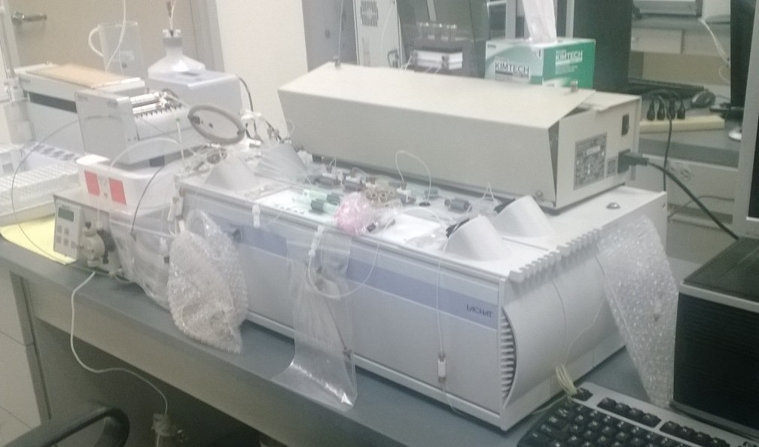
Water Testing: Inorganic
3 Ion Chromatographs
2 Flow Injection Analyzers
2 ICP-MS
1 ICP-AES
1 Auto-Titrator
Misc. Ion Specific Electrodes
Odds & Ends

Slide 5
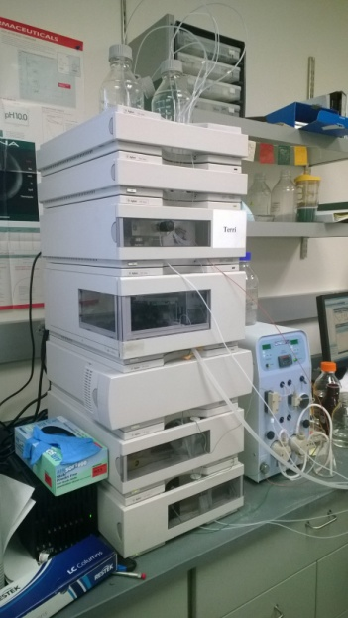
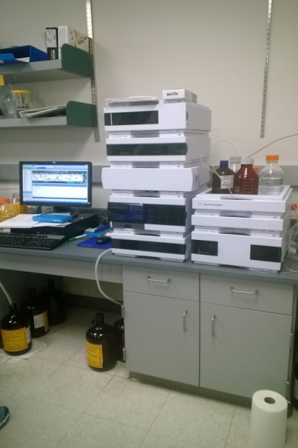
Water Testing: Organic
1 GC-MS for VOC’s
1 GC-MS for semi-volatiles
1 GC-ECD for halogenated compounds/DBP
1 TOC analyzer
LCs for Glyphosate, carbamate, pesticides

Slide 6
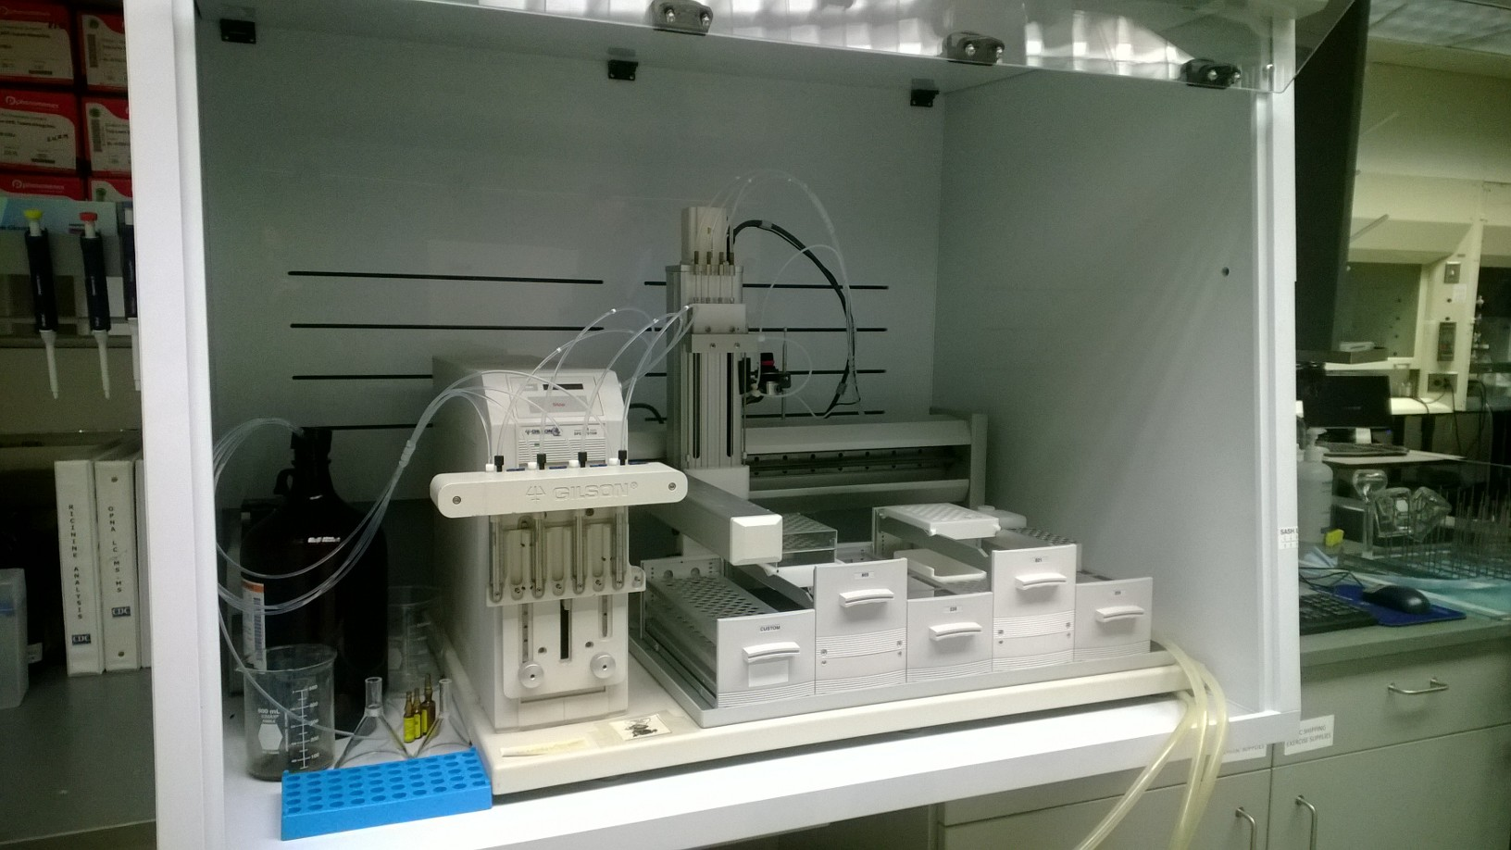
Human Testing
Sample prep:
Gilson Auto-extractor

Slide 7
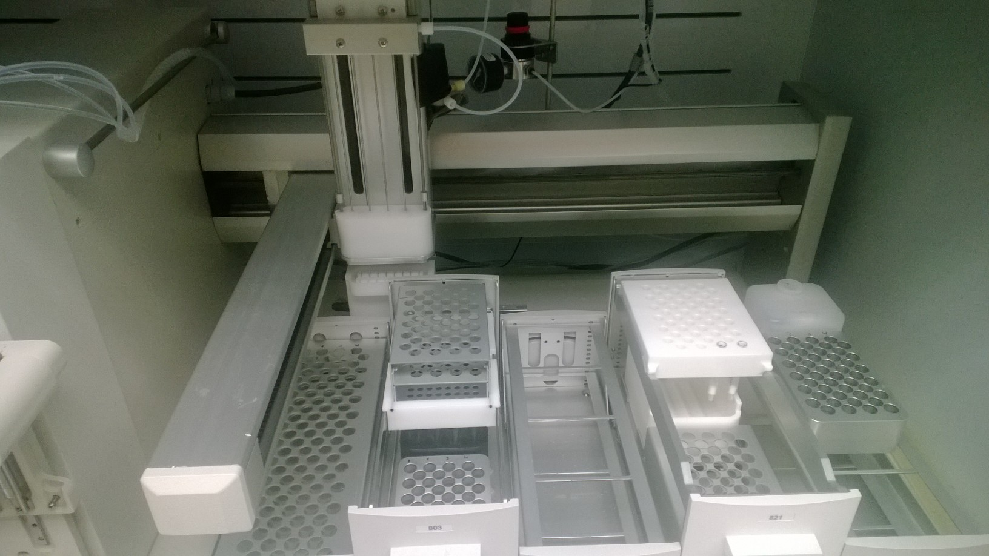
Human Testing
Gilson auto-extractor: rapid, automated solid phase extraction of toxins and metabolites from urine
Extracts analyzed by LC/MS/MS or by GC-MS

Slide 8
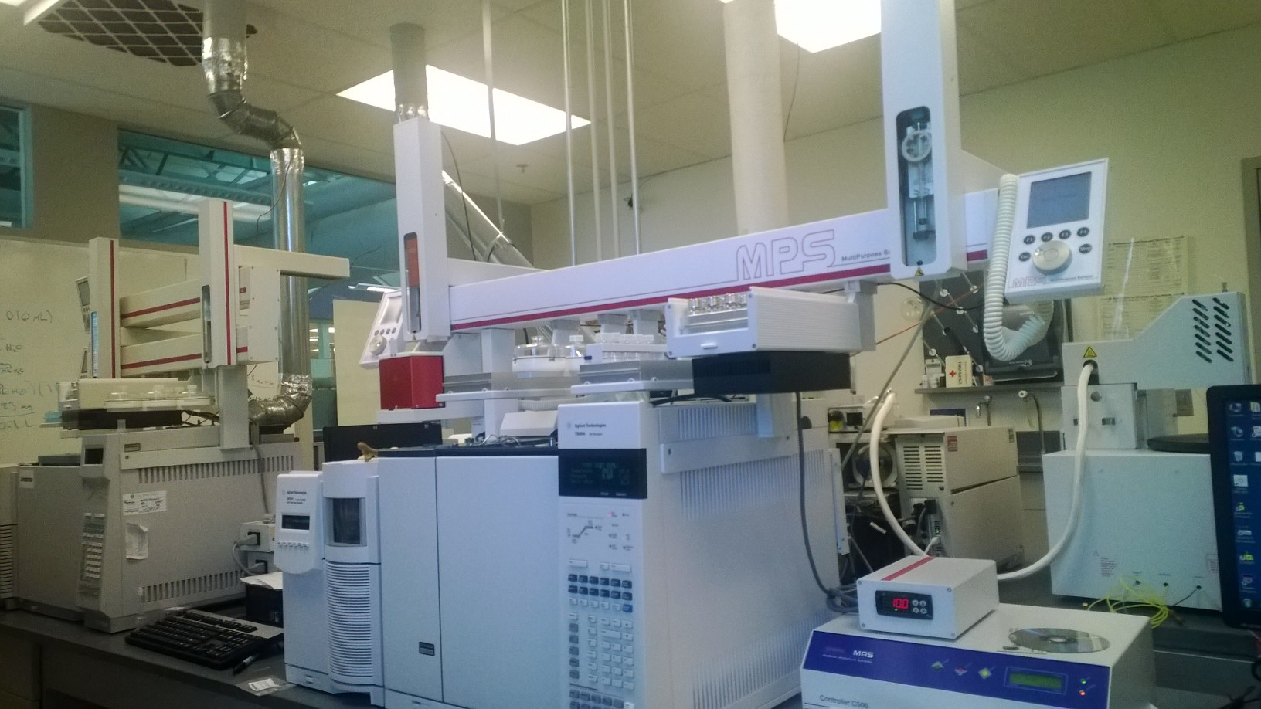
Human Testing
CDC grants allow testing of urine and blood
VOCs and cyanide by GC-MS

Slide 9
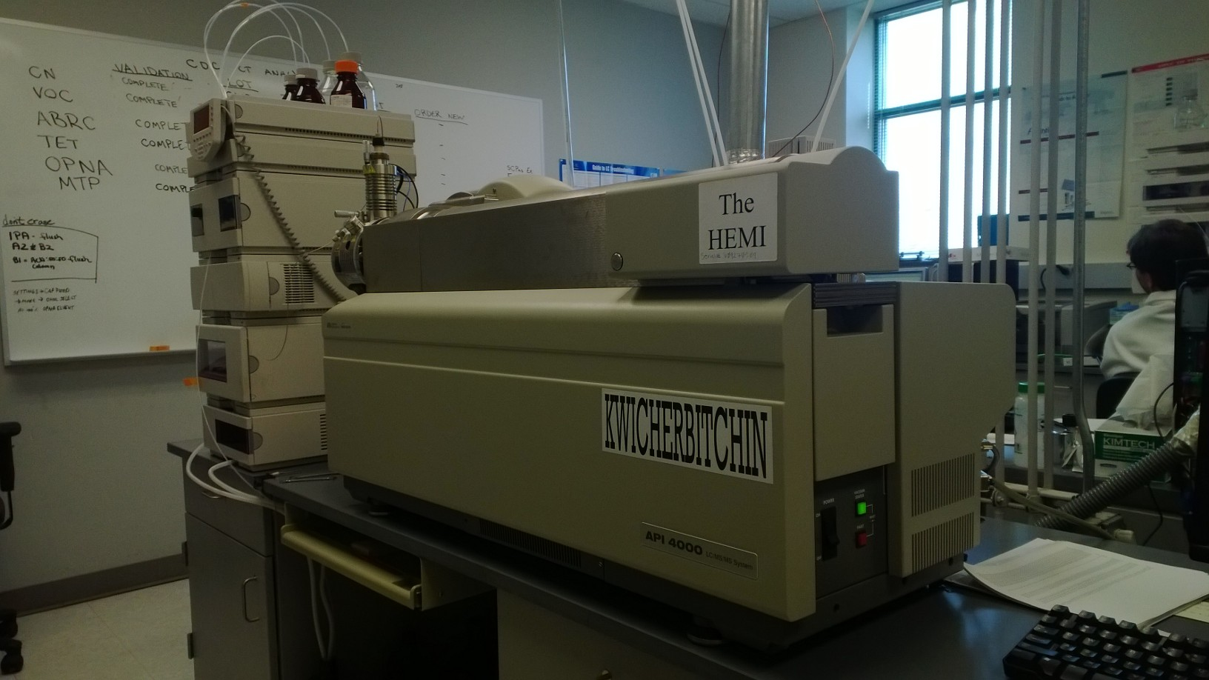
Human Testing
Chemical Terrorism Agents in Urine by LC/MS/MS

Slide 10
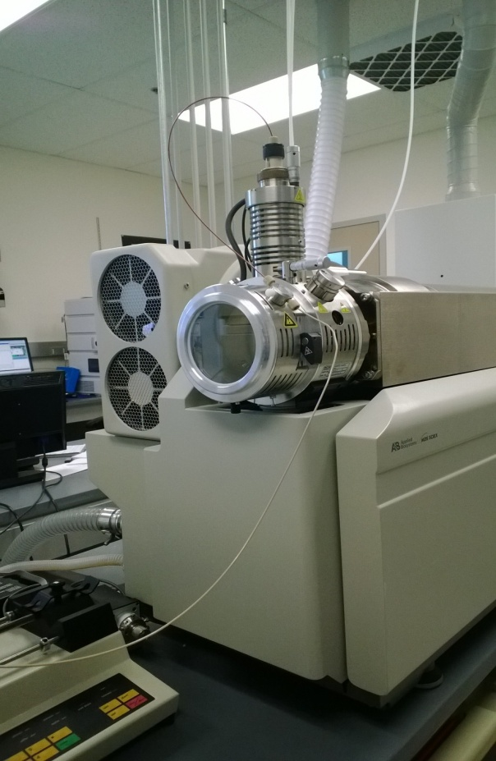
Human Testing
Chemical Terrorism Agents in Urine by LC/MS/MS
Nerve agents
Ricinine
Many others

Slide 11
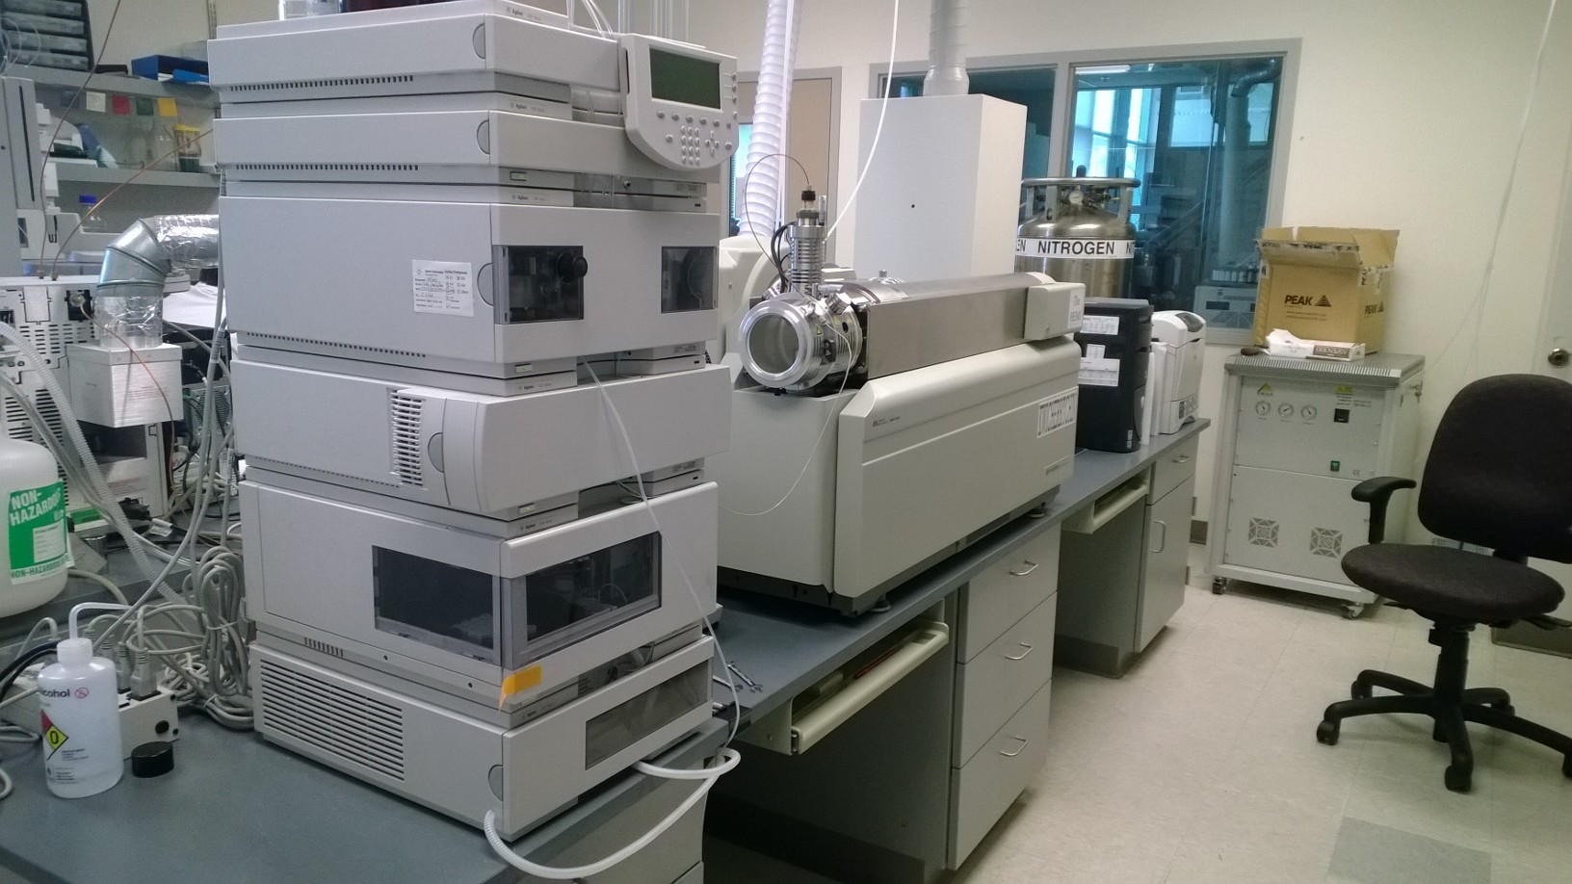
Human Testing
Chemical Terrorism Agents in Urine by LC/MS/MS

Slide 12
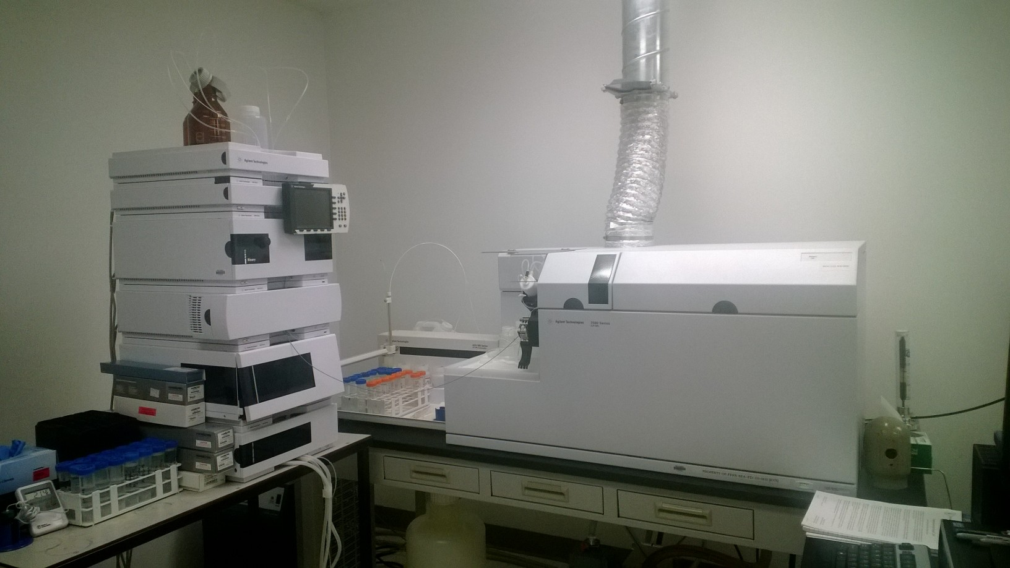
Human Testing
Biomonitoring: Speciation of metals in urine
Arsenic, Mercury, Chromium, Selenium
By LC/ICP-MS

Slide 13
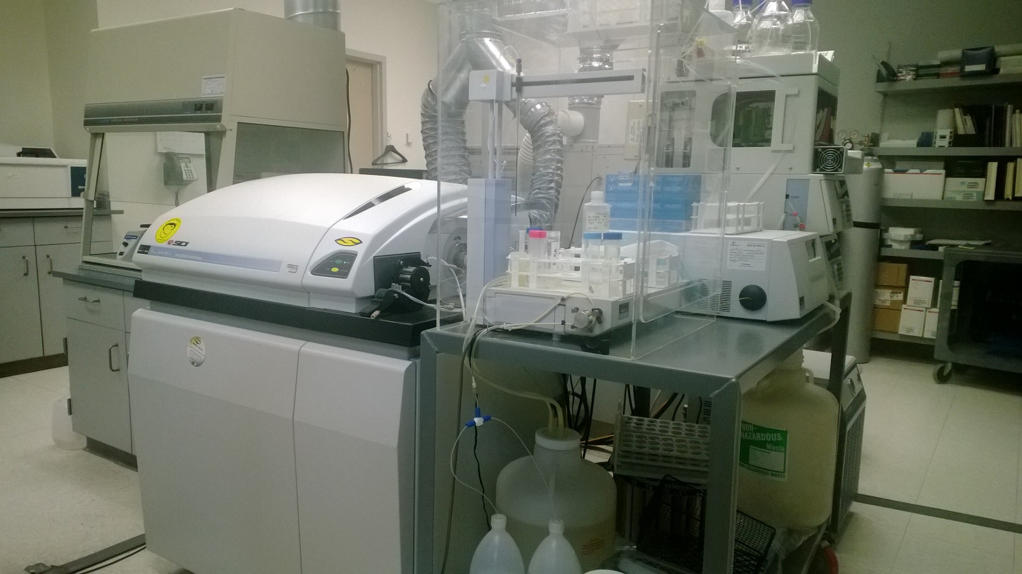
Human Testing
Metal speciation in urine and blood
By LC/ICP-MS

Slide 14
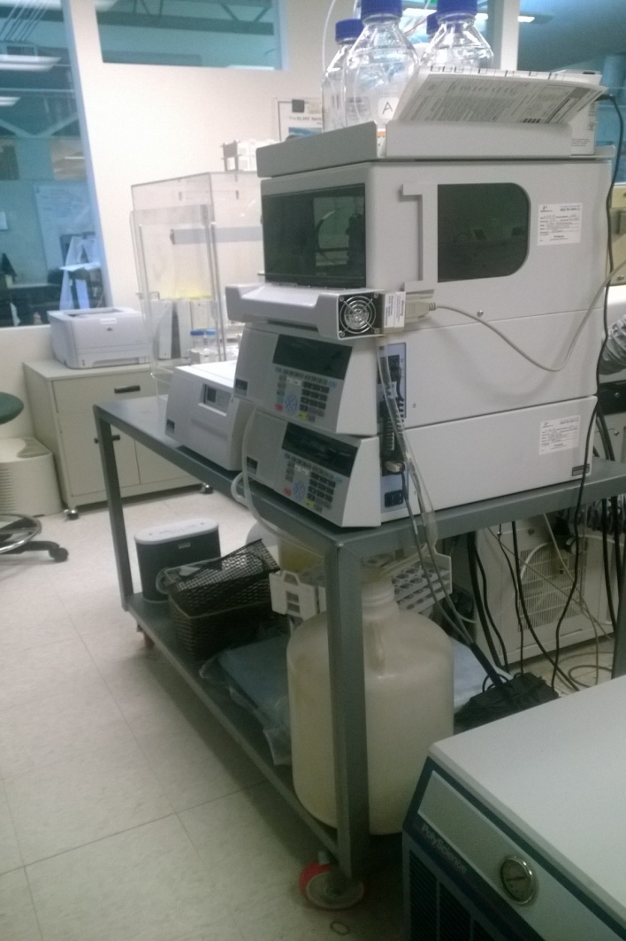
Human Testing
Metal speciation in urine and blood
By LC/ICP-MS

Slide 15
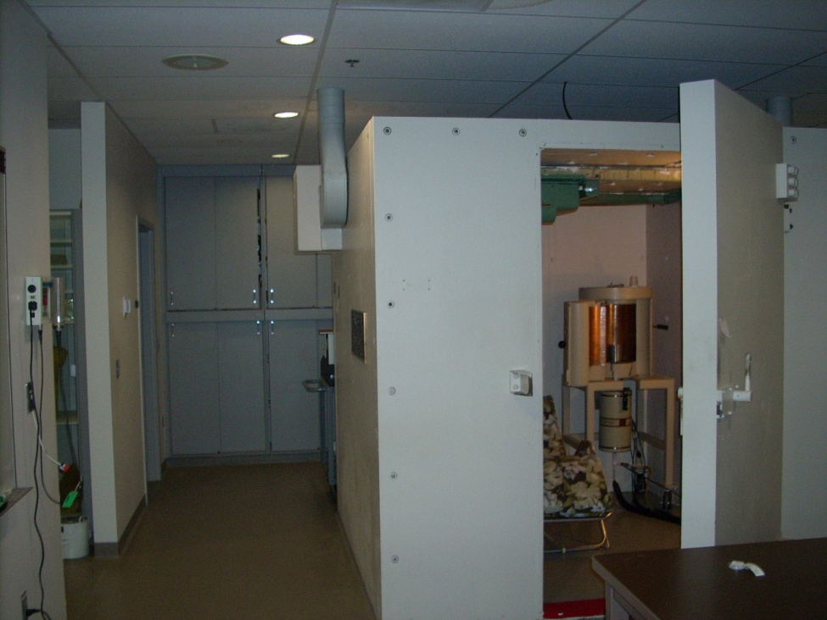
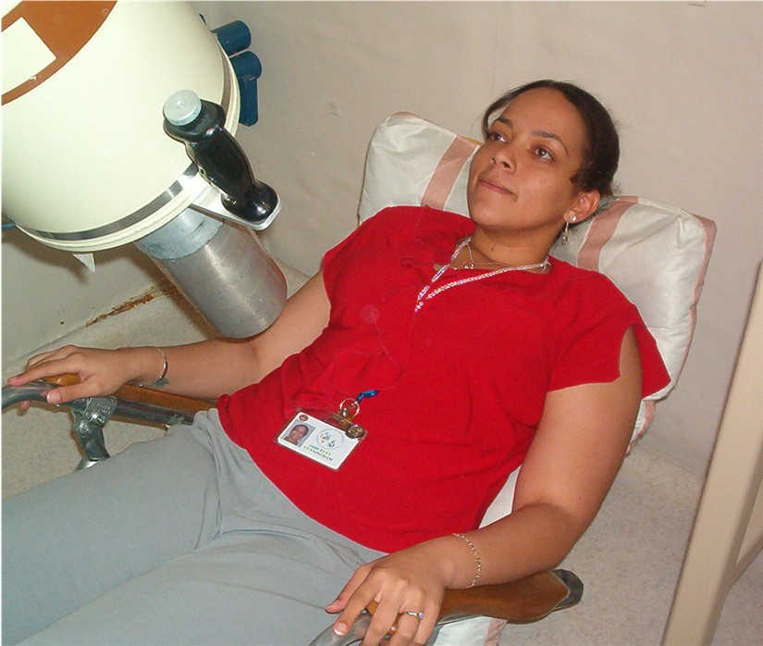
Human Testing
Radioactive Material – Whole Body Counting

Slide 16
Questions?
Thank you for your attention
Have a great weekend

