Slide 1
Blue Crew Water Stewards: Tackling the CEC Problem Through Youth Education
Carol Lyons, Andrea Stucky, Alex Key, Alani Premer
Institute for Environmental Solutions
www.i4es.org
Solutions@i4es.org

Slide 2
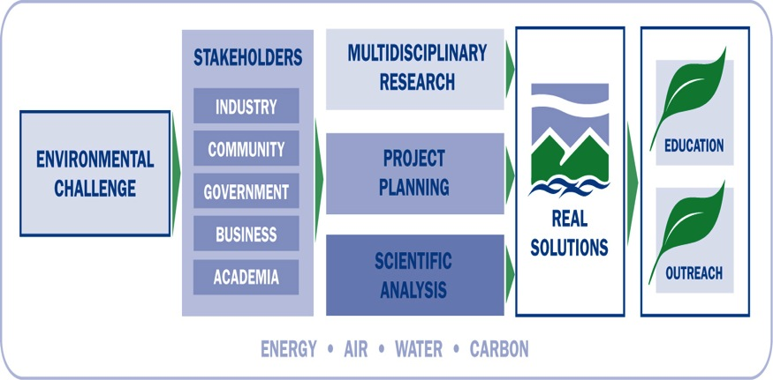
Introduction to IES
The Institute for Environmental Solutions is an independent non-profit organization that engages stakeholders to deliver technically sound solutions to complex environmental and health problems—without unwanted side effects.

Slide 3
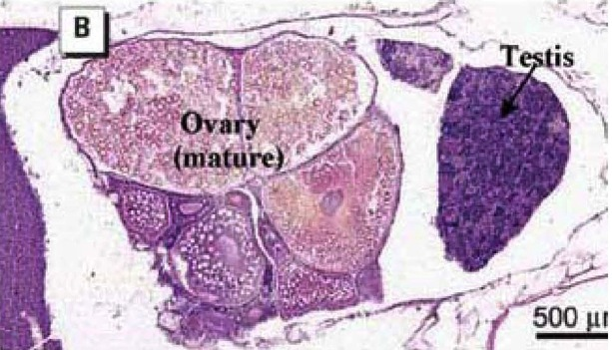
Where did the boys go?
Findings Fall 2003-Spring 2004:
Gonadal intersex
Altered sex ratio
Decrease in gonad size
Water sampling showed
mixture of endocrine-active chemicals
Conclusion: Reproductive potential of native fishes may be compromised in wastewater-dominated streams.
“Reproductive Disruption in Fish Downstream from an Estrogenic Wastewater Effluent”
Environ. Sci. Technol. 2008, 42, 3407-3414, Alan M. Vajda et al, University of Colorado and U.S. Geological Survey

Slide 4
The IES CEC Project
Mission: Reduce CEC concentrations entering wastewater and reduce human exposure to these contaminants.
Scope: Harmful contaminants in personal care, cleaning and household (indoor and outdoor) products. (Not pharmaceuticals.)
Goals:
Demonstrate that prevention is better and cheaper than treatment.
Show kids and adults how to reduce CEC water pollution and human exposure.
Foster commitment to reduce use of personal care, food, and household products containing CECs.

Slide 5
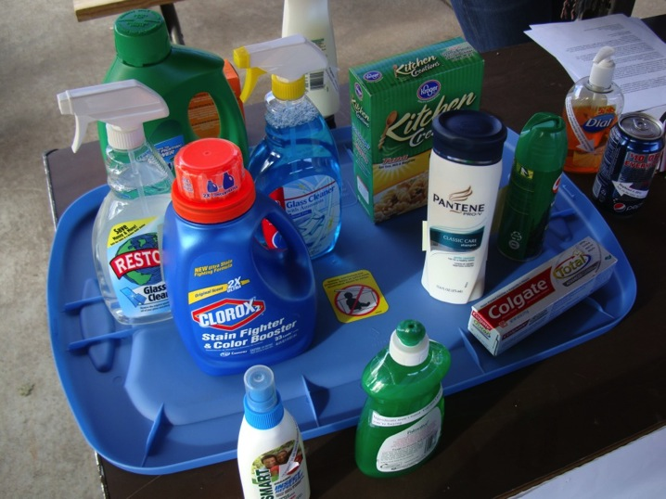
Contaminants of Emerging Concern: What are they?
Chemicals in everyday household products:
Personal care products
Cleaning products
Packaging and food
preservatives
Pesticides
Flame retardants

Slide 6
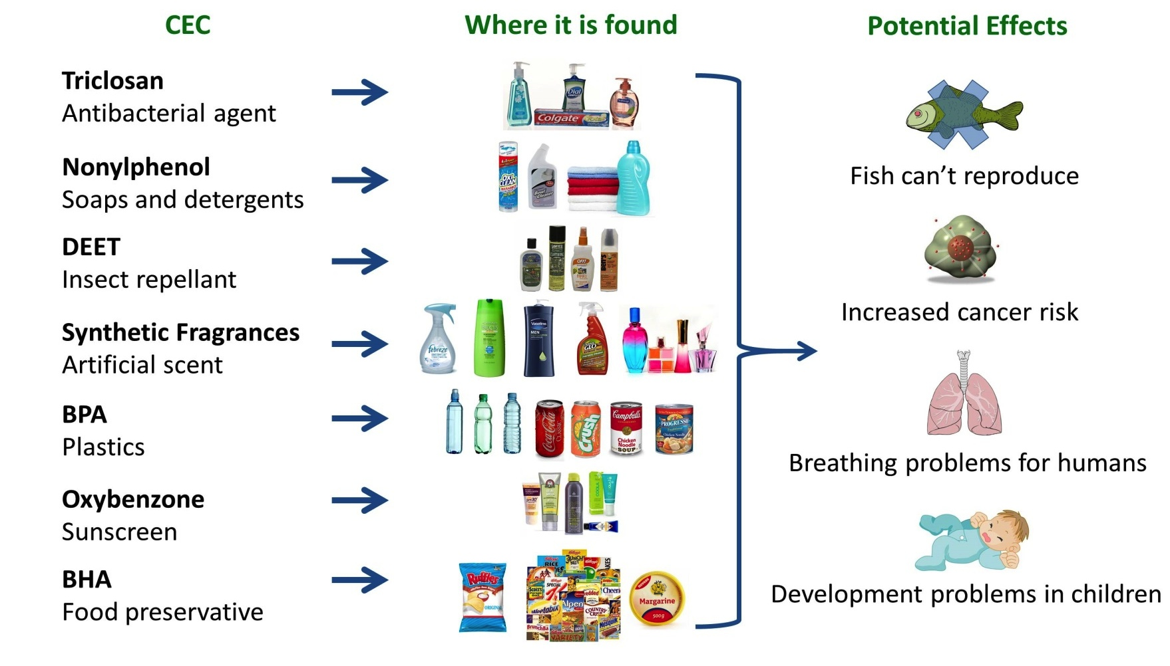
Examples

Slide 7
Environmental and health impacts
Biomagnification and bioaccumulation
Known to bioaccumulate in fatty tissues in humans and in wildlife (magnify in increasing concentrations as they move up the food chain).

Slide 8
Potential Health Risks
Health risks
Interfere with endocrine system
Interfere with development
Suspected toxins and carcinogens
Research limitations
Chemicals tested on animals and not humans
Use of dose-response curves to extrapolate
Few long-term studies

Slide 9
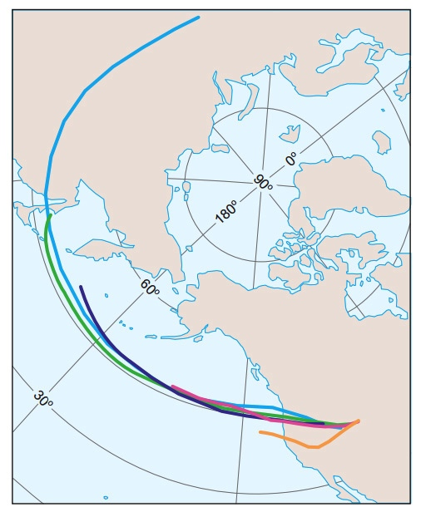
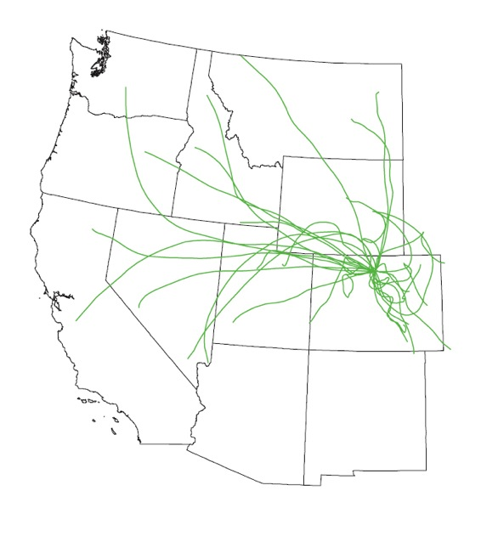
CECs don’t recognize borders
International airborne transport of contaminants to Rocky Mountain National Park (36 day trajectory)
National airborne transport of contaminants to Rocky Mountain National Park (10 day trajectory)

Slide 10
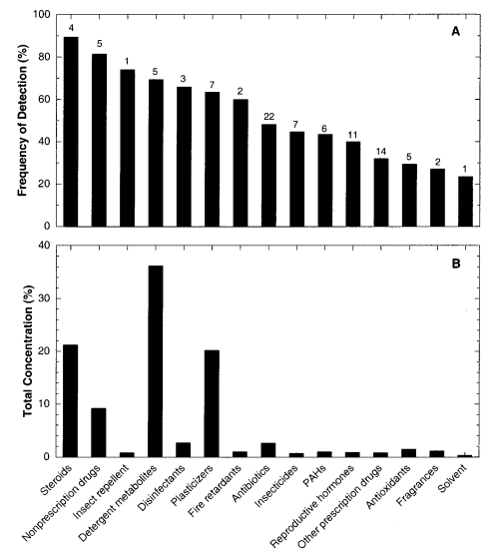
USGS Study of Stream Contaminants
Pharmaceuticals, Hormones and Other Organic Wastewater Contaminants in U.S. Streams 1999-2000
A National Reconnaissance es011055j ES&T 2002

Slide 11
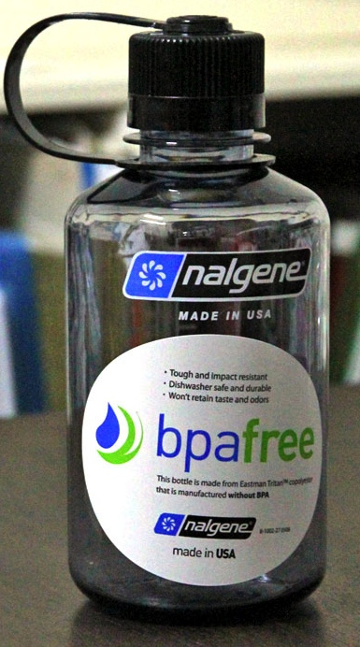
Contaminants of Emerging Concern: The Challenge
New and relatively unknown topic
Conventional focus on treatment and
analytical technology
New chemicals – unknown toxicity
and impact; lack of screening
effectiveness
Problem without a face;
don’t see direct effects
Gap between scientific research
results and public understanding

Slide 12
Contaminants of Emerging Concern: The Challenge Continued
Not regulated
Conventional wastewater treatment does not target or effectively remove
Low-dose, long-term exposure
Problem is unique: Preventable pollution
Product marketing plays a large role
Often the alternatives to harmful contaminants are just as bad

Slide 13
CECs: What to do?
Conventional regulation
Thousands of chemicals – unknown toxicity; too many to screen
Treatment
Expensive
Limited effectiveness
Unknown
Prevention
Effective
Low- or no-cost
Reduce / eliminate harm to human health and the environment
Individual actions of people can make a difference

Slide 14
Community-based Social Marketing (CBSM)
Education alone has little or no effect on sustainable behavior
Little or no relationship between attitudes or knowledge, and behavior.
Behavior change –
Three pillars:
Commitment – good intentions
to action
Norms – build community support
Prompts – remember to act
Fostering Sustainable Behavior - Doug McKenzie-Mohr, www.cbsm.com

Slide 15
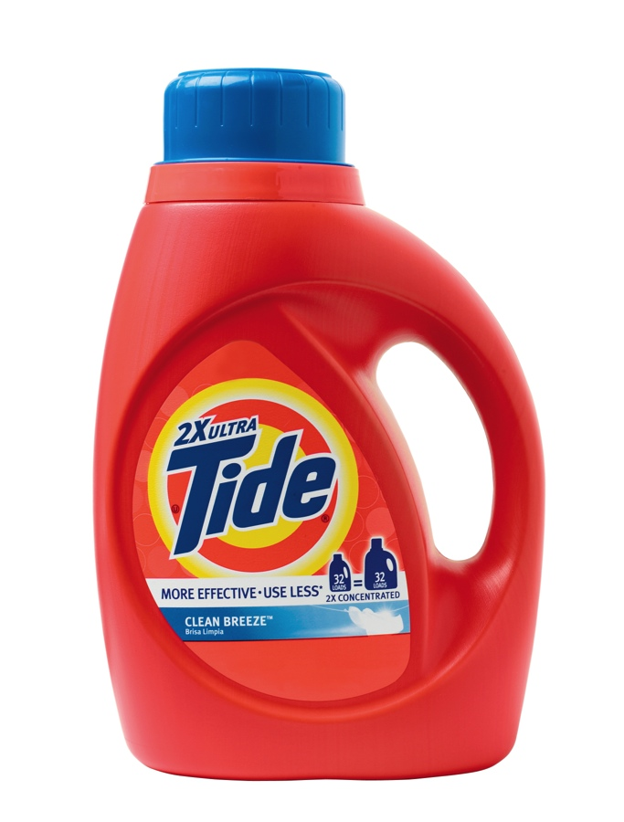
Case Study: Bismarck, ND
Nonylphenol contamination
Pretreatment approach – working with
local businesses and industry
Social and community benefits of switching
to NP-free detergents
Not mandatory
90% ongoing success
SOLUTION:
Community approach: small business, households, schools, community groups
Two potential approaches: addressing household contaminants (Blue Crew) and/or community-wide and commercial/industrial sources

Slide 16
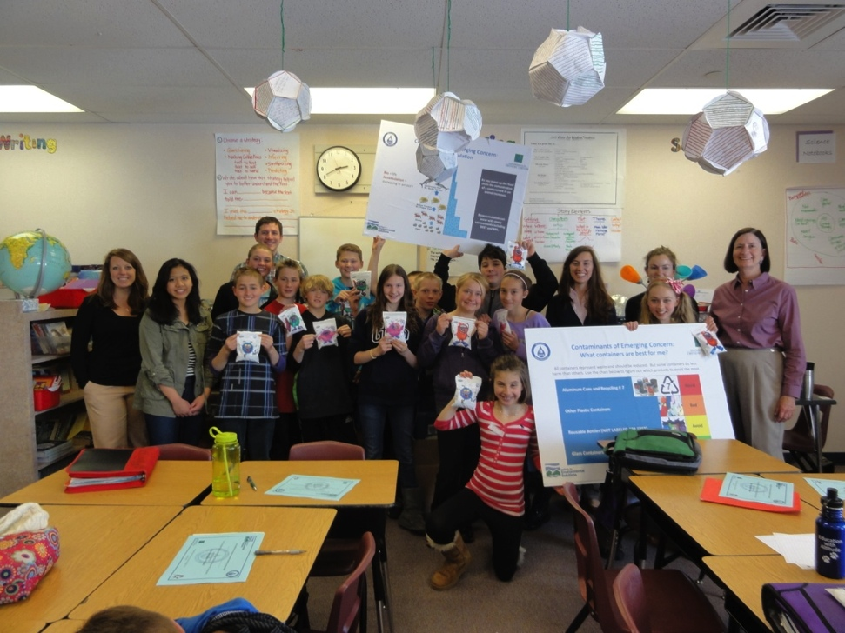
Blue Crew Water Stewards Workshops
Promote water stewardship through existing social networks
Establish an environmental ethic
Reduce and prevent water pollution at the household level
Hands on education on
how to reduce your
chemical footprint
Methodology: Interactive
and hands-on activities
Experimentation
CEC-free product creation
Props (plants, aquatic wildlife, and sample products)

Slide 17
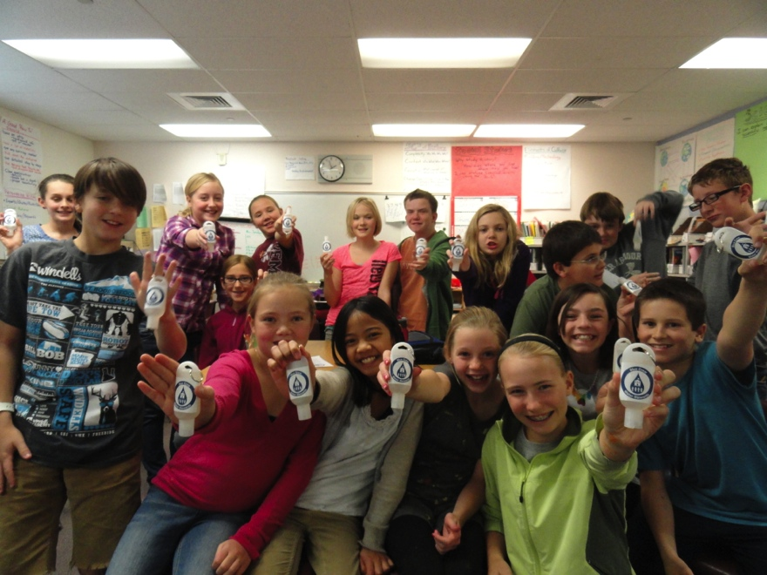
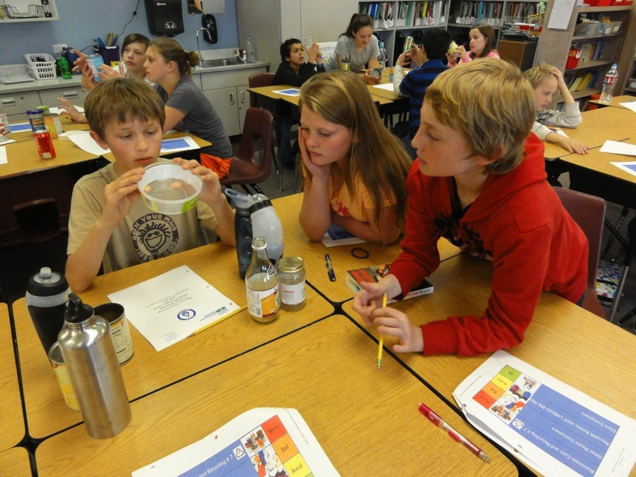
Blue Crew Water Stewards Workshops
3 workshops series:
BPA – voluntary commitment to reduce chemical footprint
DEET – aquatic life in Clear Creek (the water supply); make your own DEET-free bug repellent
BHA – create your own contaminant-free snack

Slide 18
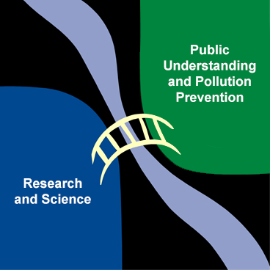
Building Bridges
Building on Blue Crew Water Stewards
Community stakeholder involvement / collaboration
CBSM is how we build the bridge
Next steps: Pilot programs to demonstrate community-based prevention to solve a CEC problem.

Slide 19
Conclusions
Community knowledge about CECs and potential harm is very low
Traditional education / outreach is not effective
People are willing to change their behavior in response to community-based one-on-one education and outreach
Preventing CEC pollution from personal care and household products is feasible.
Cheaper and easier to keep CECs from entering waterways than to treat downstream

Slide 20
Contaminants of Emerging Concern – Linking Science to Effective Action: Next Steps
Looking for collaboration and team opportunities
Current issues in your community
_____________________________
____________________________

Slide 21
The CEC Project Team
Carol Lyons Patrick DePriest
Andrea Stucky Bruce Lundgren
Elodie Boucher Alex Key
Alani Premer
Join or contribute to the IES CEC Project!
Volunteer!
Join the Steering Committee! (Meets quarterly)
Contribute: www.ColoradoGives.org/i4es
Quarterly e-newsletter: Newsletter@i4es.org
Solutions@i4es.org 303-388-5211

Slide 22
Questions / Discussion

