Slide 1
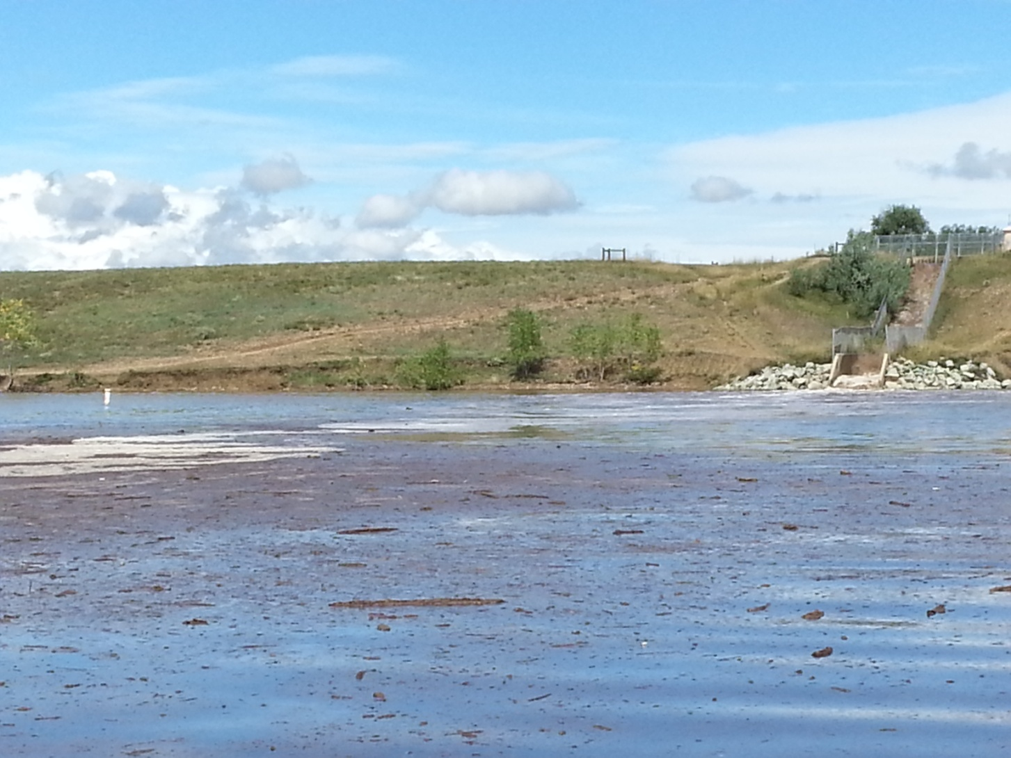
Boulder Reservoir Flood September 2013
Jim Shelley City of Boulder
RMWQAA 2014 Symposium
4/25/2014

Slide 2
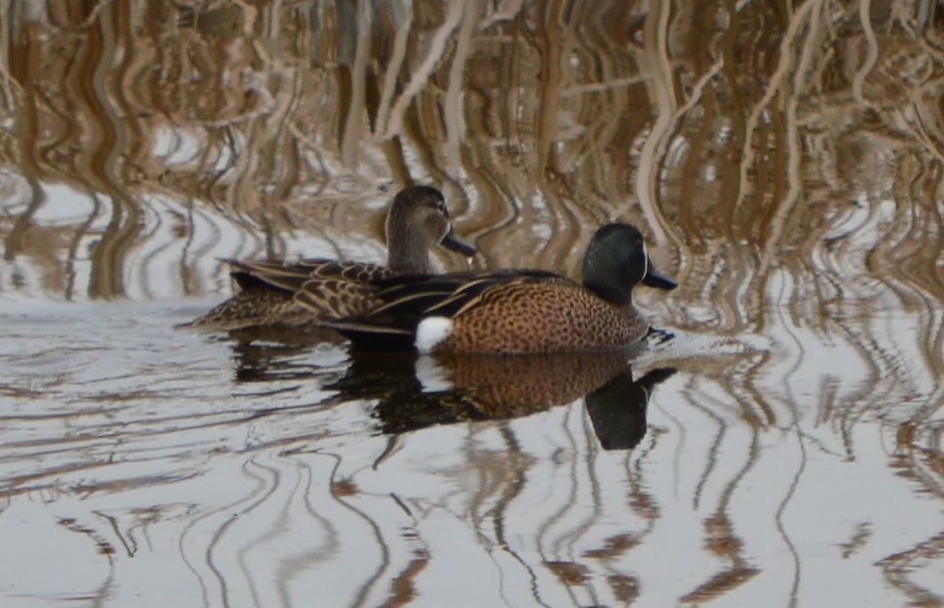
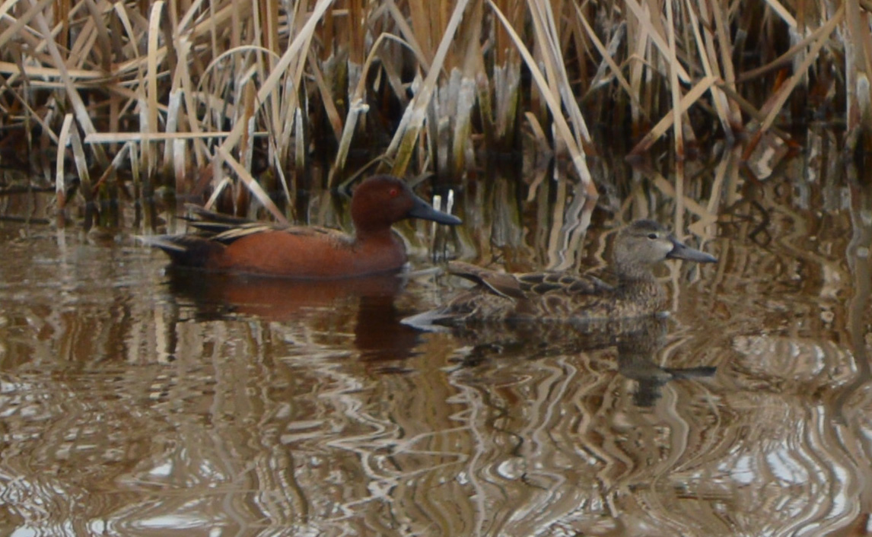

Slide 3
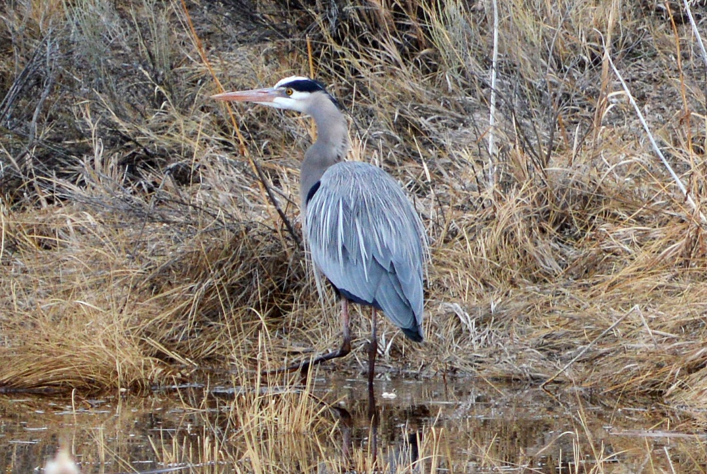
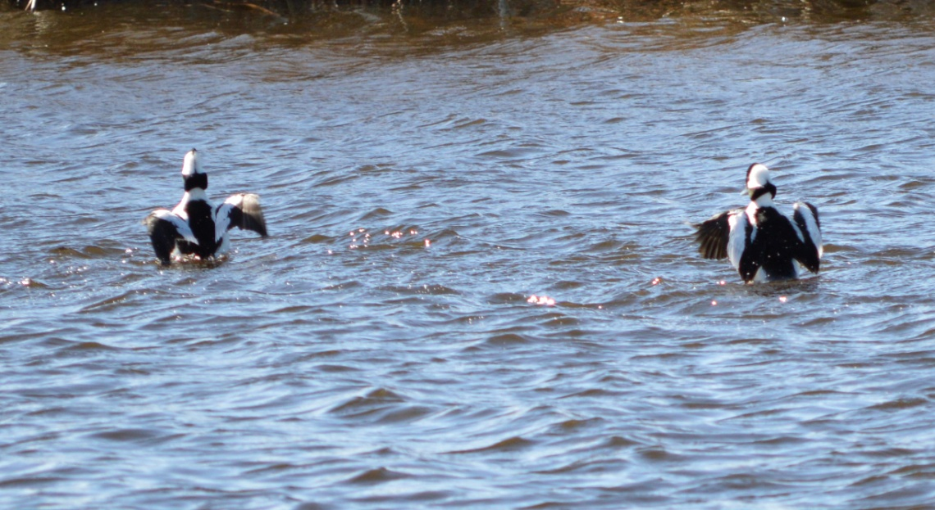

Slide 4
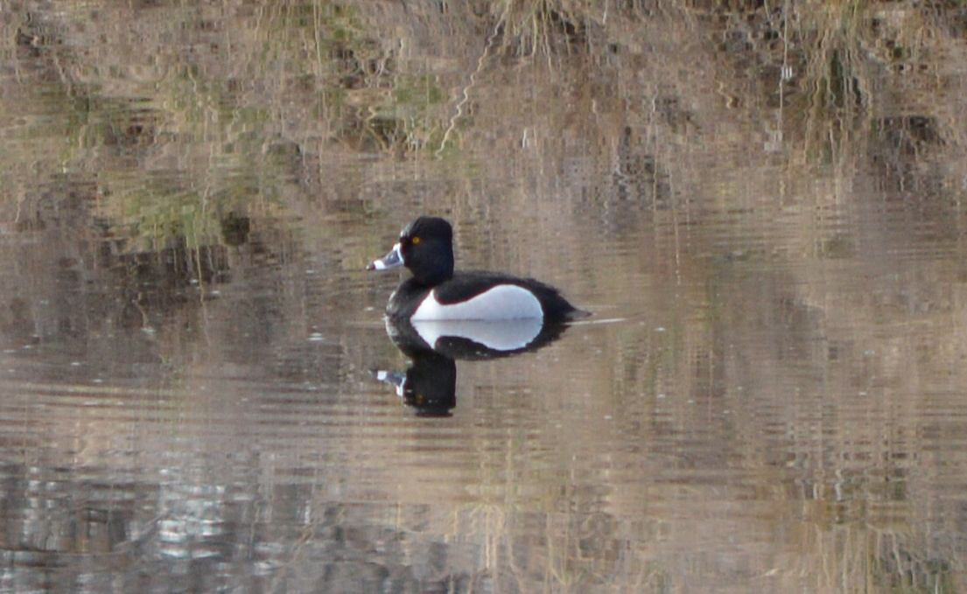
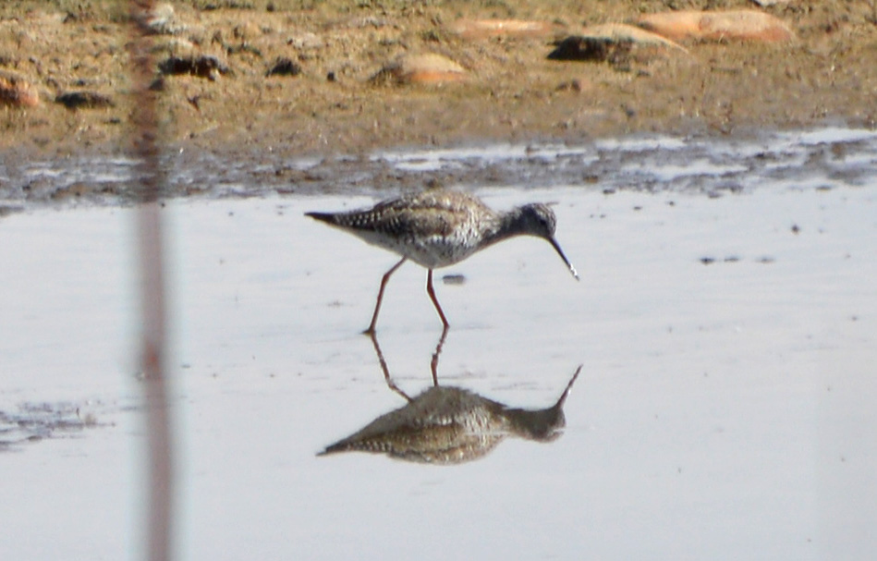
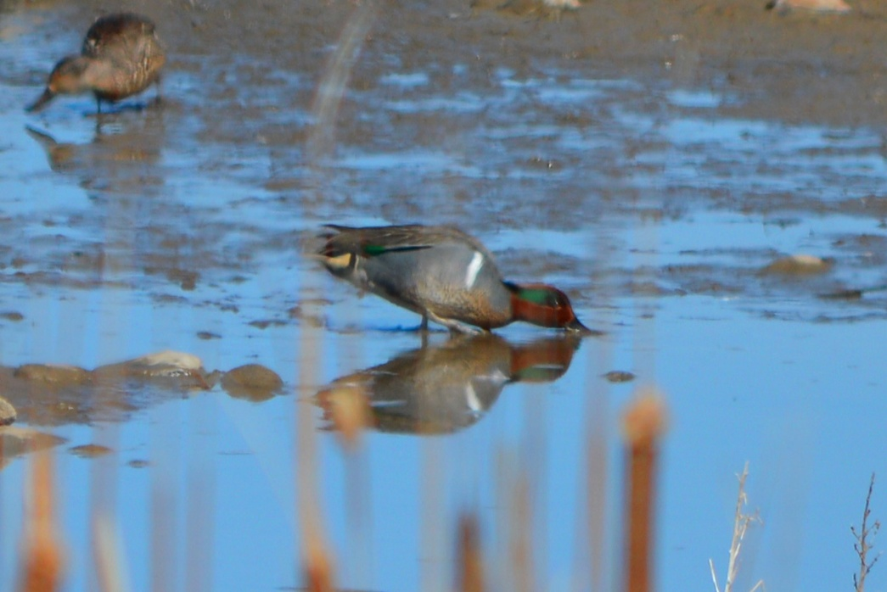

Slide 6
Acknowledgements
City of Boulder Drinking Water Quality Lab
Zach Lelwica
Anu Thorat
City of Boulder Waste Water Quality Lab
Kurt Keilbach
Melissa Mimna
Rick Dingeman

Slide 7
Presentation Topics
Flood Water Sources
Reservoir Net Volume Increase
Tributary Flood Photos and Water Quality Data
Tributary Loads
Reservoir Condition Before and After the Flood
14 year trends showing the historic Sept 2013 flood impact

Slide 8
Three Major Sources of Flood Water into Boulder Reservoir
Saint Vrain River
Via Boulder Feeder
Canal (1000 acft)
Dry Creek (200 acft)
Six Mile Reservoir
Spillway (1400 acft)

Slide 9
Boulder Reservoir Volume Increase from Flood
3200 acft volume gain 48 hours 9/12 through 9/14
Estimated 600 acft from 12 inches rain
Net gain 2600 acft from flood

Slide 10
Six Mile Reservoir (9/12/13)
Water Quality Data (9/17)
TSS- 101 mg/L
NO₃- 0.77 mg/L
TP- 254 ug/L
DP- 89 ug/L

Slide 11
Saint Vrain River via Boulder Feeder Canal (9/13/13)
Water Quality Data (9/17)
TSS- 44 mg/L
NO₃- 1.58 mg/L
TP- 118 ug/L
DP- 42 ug/L

Slide 12
Dry Creek (9/13/13)
Water Quality Data (9/17)
TSS- 50 mg/L
NO₃- 1.52 mg/L
TP- 206 ug/L
DP- 78 ug/L

Slide 13
Boulder Reservoir Estimated Flood Loading Rates
TSS – 530,841 lbs 265 tons 221 cubic yards (2.2x avg annual load)
NO₃ as N - 9036 lbs (3.7x)
TP - 1352 lbs (1.6x)
DP - 490 lbs (1.5x)

Slide 14
Boulder Reservoir Clarity
Parameter | Pre-Flood (9/3) | During Flood (9/13) | Flood Waters Recede (9/17) | Post Flood (10/8) | 11/5 | 12/3 | 1/17 | 2/24 | 4/1
Turbidity (ntu) | 6 | 580 | 50 | 31 | 24 | 24 | 9 | 13 | 13
TSS (mg/L) | 7 |  | 27 | 19 | 15 | 15 | 7 | 11 | 14
Secchi (m) | 1.2 |  | 0.3 | 0.4 | 0.5 | 0.6 | 1.1 | 0.6 | 0.7

Slide 15
Boulder Reservoir Turbidity 14 Year Trend

Slide 16
Boulder Reservoir E-coli and Chlorophyll a
Parameter | Pre -Flood (9/3) | During Flood (9/13) | Flood Waters Recede (9/17) | Post Flood (10/8) | 11/5 | 12/3 | 1/17 | 2/24 | 4/1
E-coli (cfu/ 100mls) | 3 | 800 | 7 | 9 | 28 | 3 | 1 | 3 | <1
Chlorophyll a (ug/L) | 5.0 |  | 8.8 | 25.0 | 13.8 | 10.7 | 9.1 | 6.6 | 8.3

Slide 17
Boulder Reservoir Chlorophyll a 14 Year Trend

Slide 18
Boulder Reservoir Nutrients
Parameter | Pre-Flood (9/3) | Flood Waters Recede (9/17) | Post Flood (10/8) | 11/5 | 12/3 | 1/17 | 2/24 | 4/1
TP (ug/L) | 23 | 100 | 83 | 49.9 | 47.4 | 27.5 | 41.6 | 36.2
DP (ug/L) | 5 | 31 | 24 | 8.4 | 10.0 | 6.6 | 11.5 | 5.6
OP (ug/L) | <2.5 | 8.5 | <2.5 | <2.5 | <2.5 | <2.5 | <2.5 | <2.5
TN (ug/L) | 401 | 665 | 714 | 805 | 726 | 520 | 559 | 562
NO3 (ug/L) | <4 | 145 | 74 | 175 | 246 | 99 | 89 | 72
TOC (mg/L) | 3.4 | 5.8 | 5.2 | 5.1 | 4.8 | 4.8 | 4.6 | 4.7

Slide 19
Boulder Reservoir Total P 14 Year Trend

Slide 20
Boulder Reservoir Dis P 14 Year Trend

Slide 21
Boulder Reservoir Nitrate 14 Year Trend

Slide 22
Boulder Reservoir TOC 14 Year Trend

Slide 23
Boulder Reservoir Post Flood Metals, VOC’s, SOC’s & EC’s
Metals
Al, Fe increased
Be, Cd, Cr, Cu, Pb, Mo, Se, U, Zn slight increases-below aquatic life limits
VOC’s- all less than detection
SOC’s- all less than detection
Emerging contaminants- first time low level hits for Bisphenol A and Triclosan
ANS

Slide 24
Boulder Reservoir post flood monitoring will continue focusing on taste and odors, DBP precursors and reservoir condition

Slide 25
Boulder Reservoir post flood monitoring will continue focusing on taste and odors, DBP precursors and reservoir condition

Slide 26
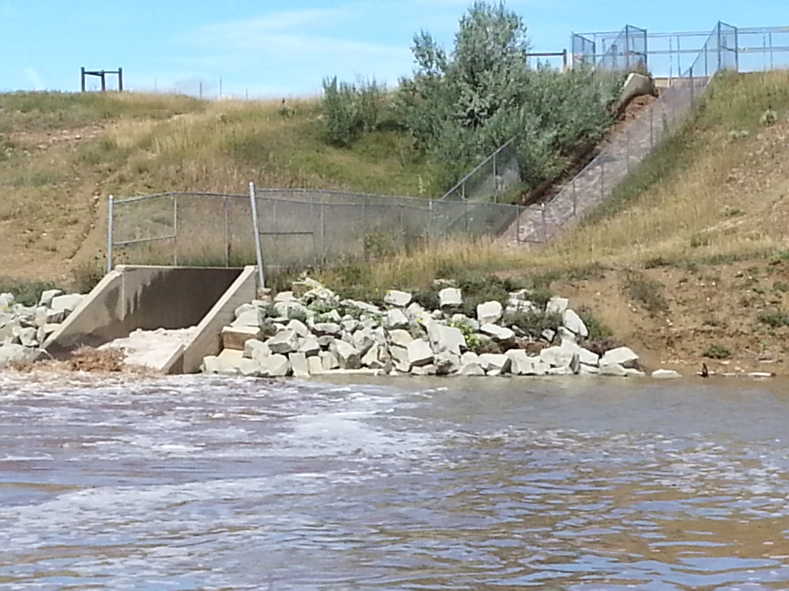
Monitoring will continue focusing on taste and odor, DBP’s and reservoir condition

Slide 27
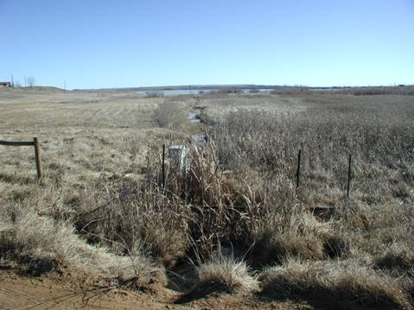
Tributaries
Farmers
Dry Creek
Little Dry
Unk
BFC

Slide 29
Physical Characteristics
13,000 acft
580 acres
Max Depth 28 ft
Mean Depth 23 ft
Fetch 1.2 miles
Shoreline Length 5.1 miles
Shoreline Development 1.51

Slide 30
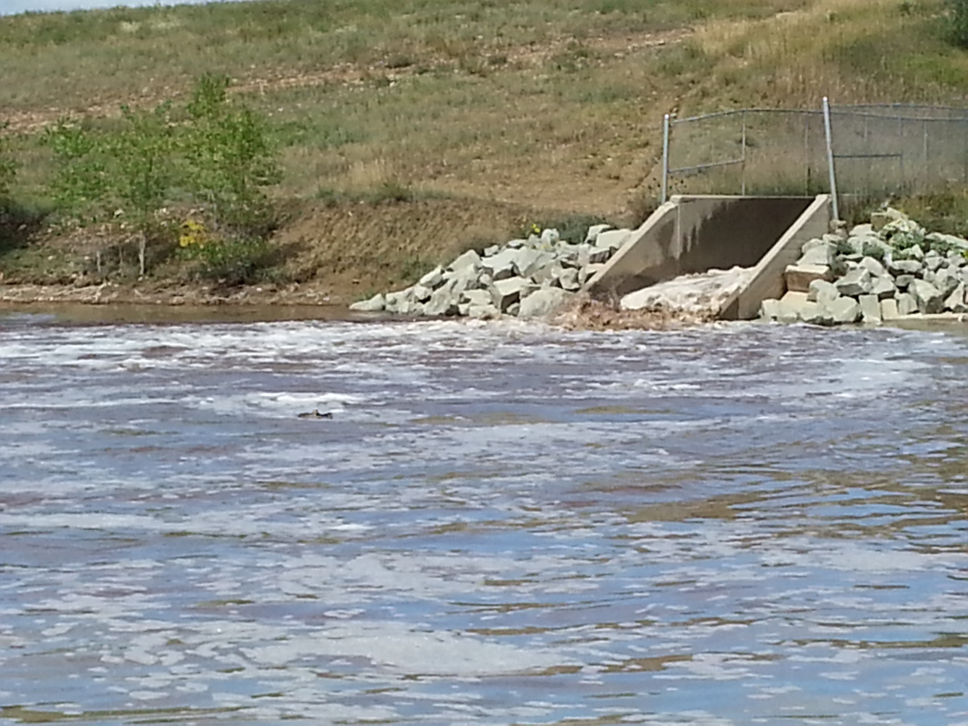
Monitoring will continue focusing on taste and odor, DBP’s and reservoir condition

