Slide 1
Stream Sampling for Benthic Macroinvertebrates
Presented By:
Grant De Jong
What are the bugs telling us?
And who understands them?
Rocky Mountain Water Quality Analysts Association
2014 Annual Symposium
April 25, 2014

Slide 2
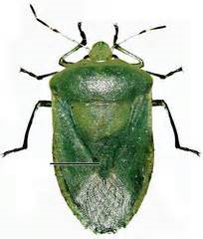
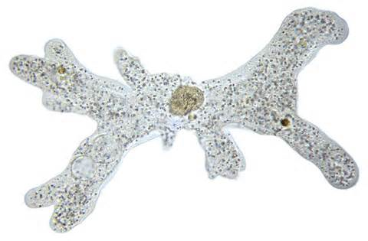
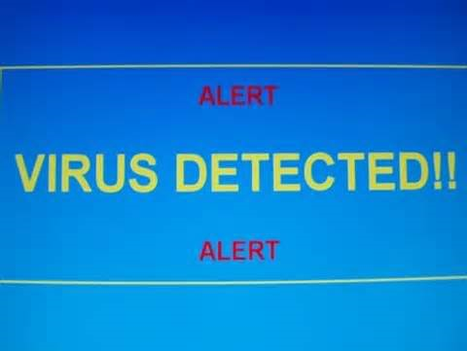
“Benthic Macroinvertebrates”? “Bugs”?
This?
This?
Heteroptera?
An aquatic, multicellular animal without a backbone and large enough to be seen with the naked eye.

Slide 3
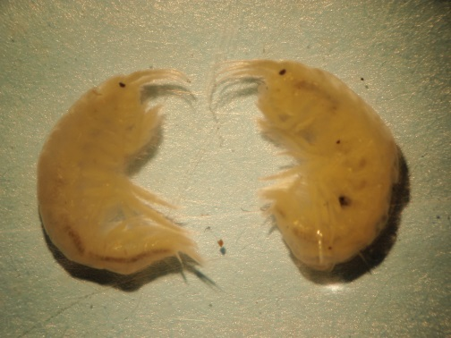
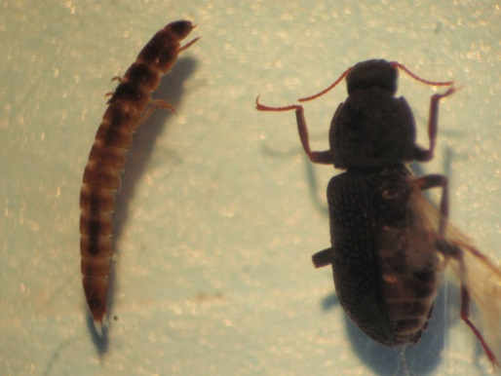
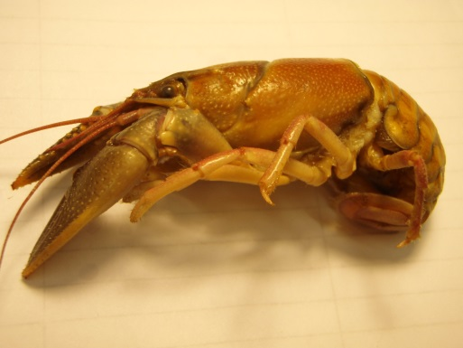
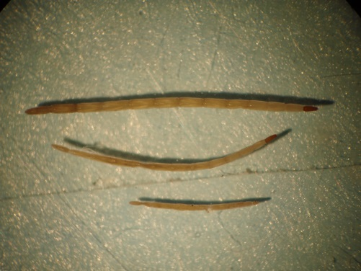
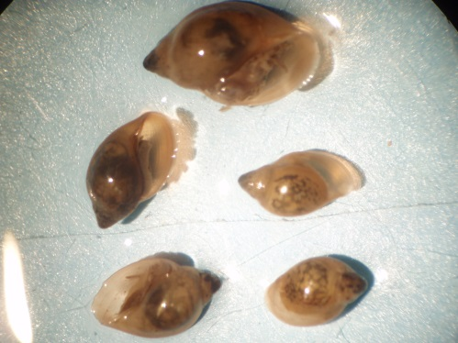
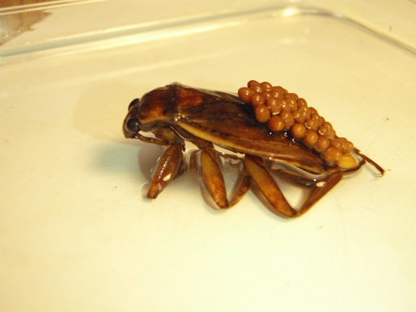
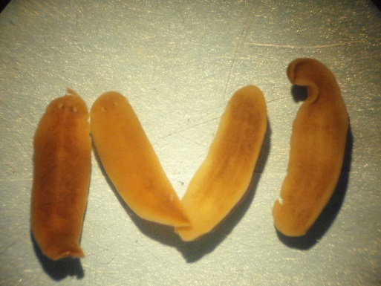
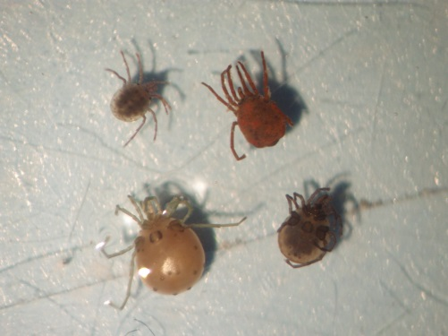
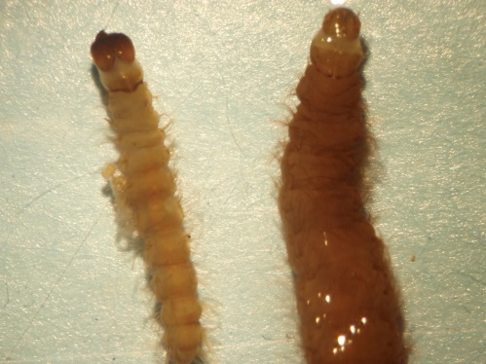
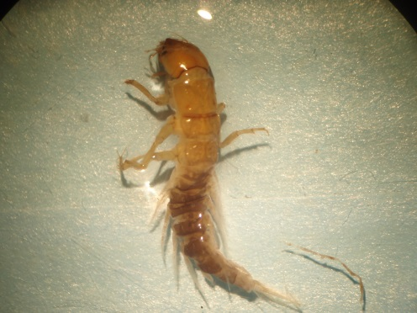
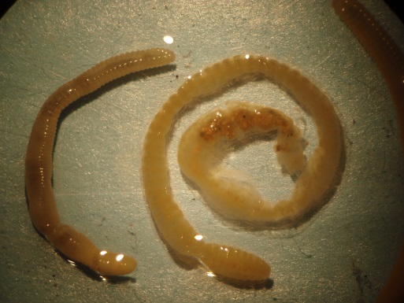
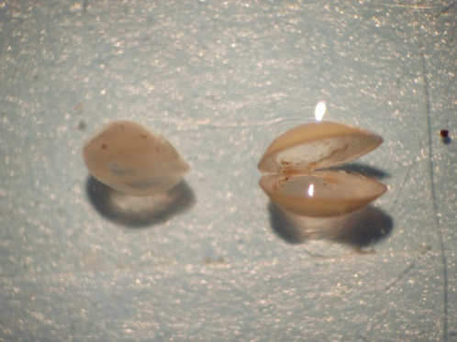
Who are they?

Slide 4
Step 1 – Collect your bugs

Slide 5
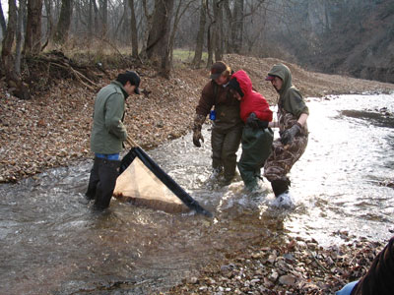
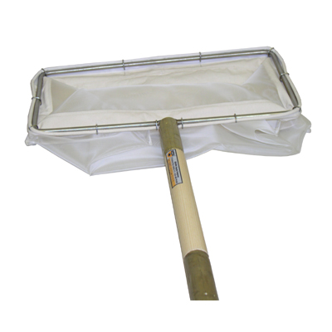
Kick Net (qualitative, or, at best, semi-quantitative)
This is the “kick net” some people use
This is the kick net I prefer to use
Use it to sample habitat other than riffles

Slide 6
Qualitative – presence/absence, maybe some relative abundance
Gives us a “Who’s there” approach
Not generally amenable to statistical analysis
Quantitative – numbers
Usually reported in #/m²
Replication
Gives us ability to run statistics
ANOVA, t-tests, etc.

Slide 7
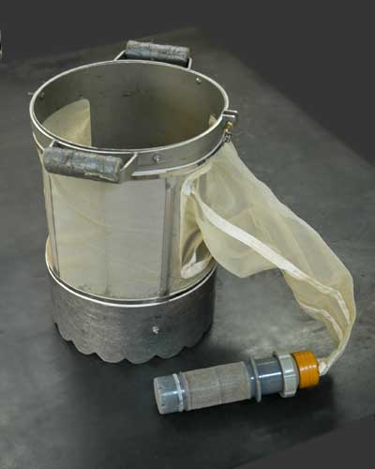
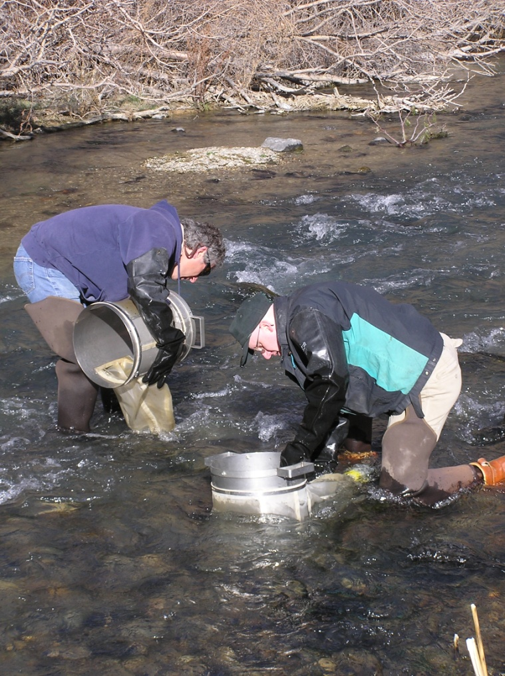
Hess sampler
Originally designed for use in soft-bottom streams in the East.
Steve Canton and Jim Chadwick modified it for the cobble-bottom streams of Colorado and the West.

Slide 8
Colorado State Protocol
Uses a semi-quantitative approach:
1 kick net sample in 1 m² of riffle habitat over 60 seconds
Since this was done at 100’s of sites, the data can be used in a regional approach
Individual sites can be compared to the region, but not to each other

Slide 9
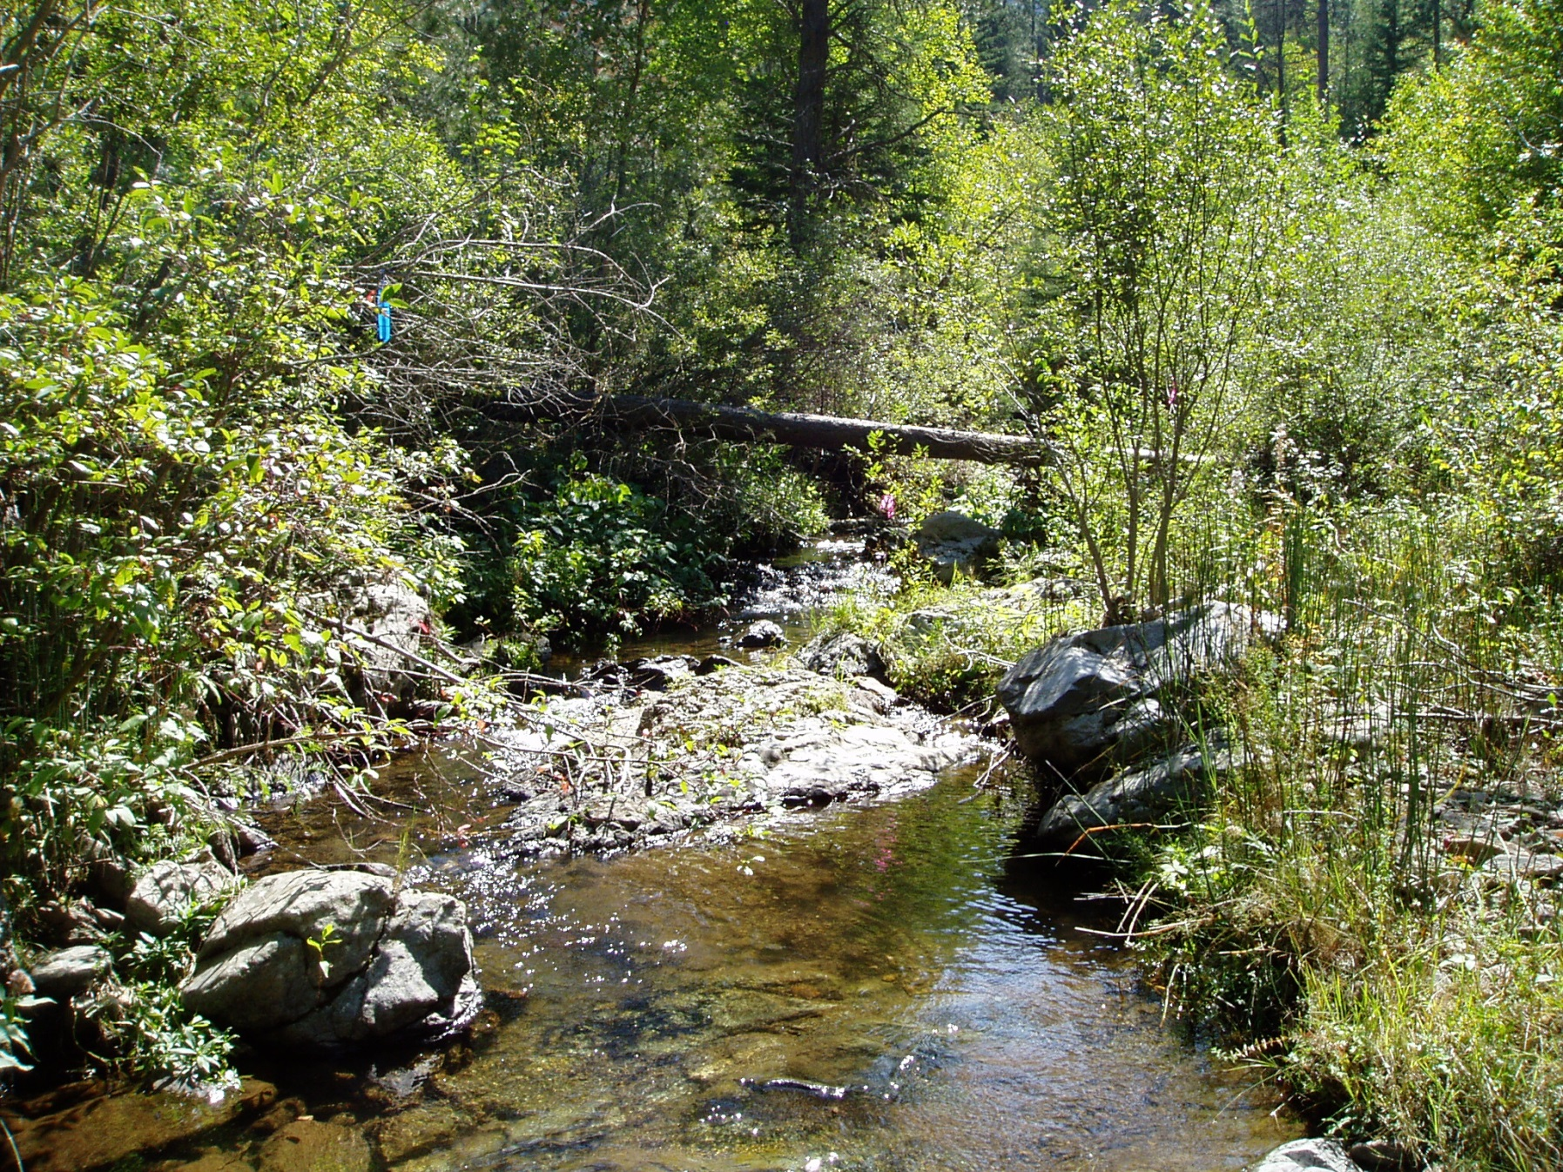
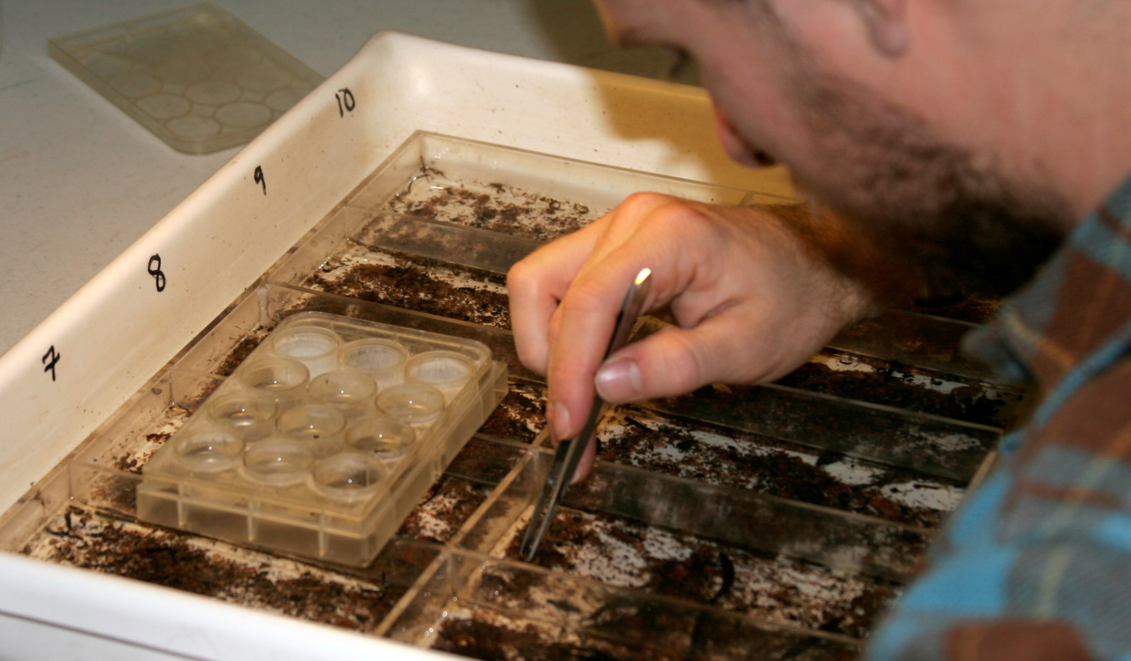
Step 2: Lab work
Samples come to the lab filled with
Sticks
Stones
Grass
Algae
Mud
Sand
Unidentifiable
plastic stuff
and Bugs!
Someone gets to sort the bugs from all that debris.

Slide 10
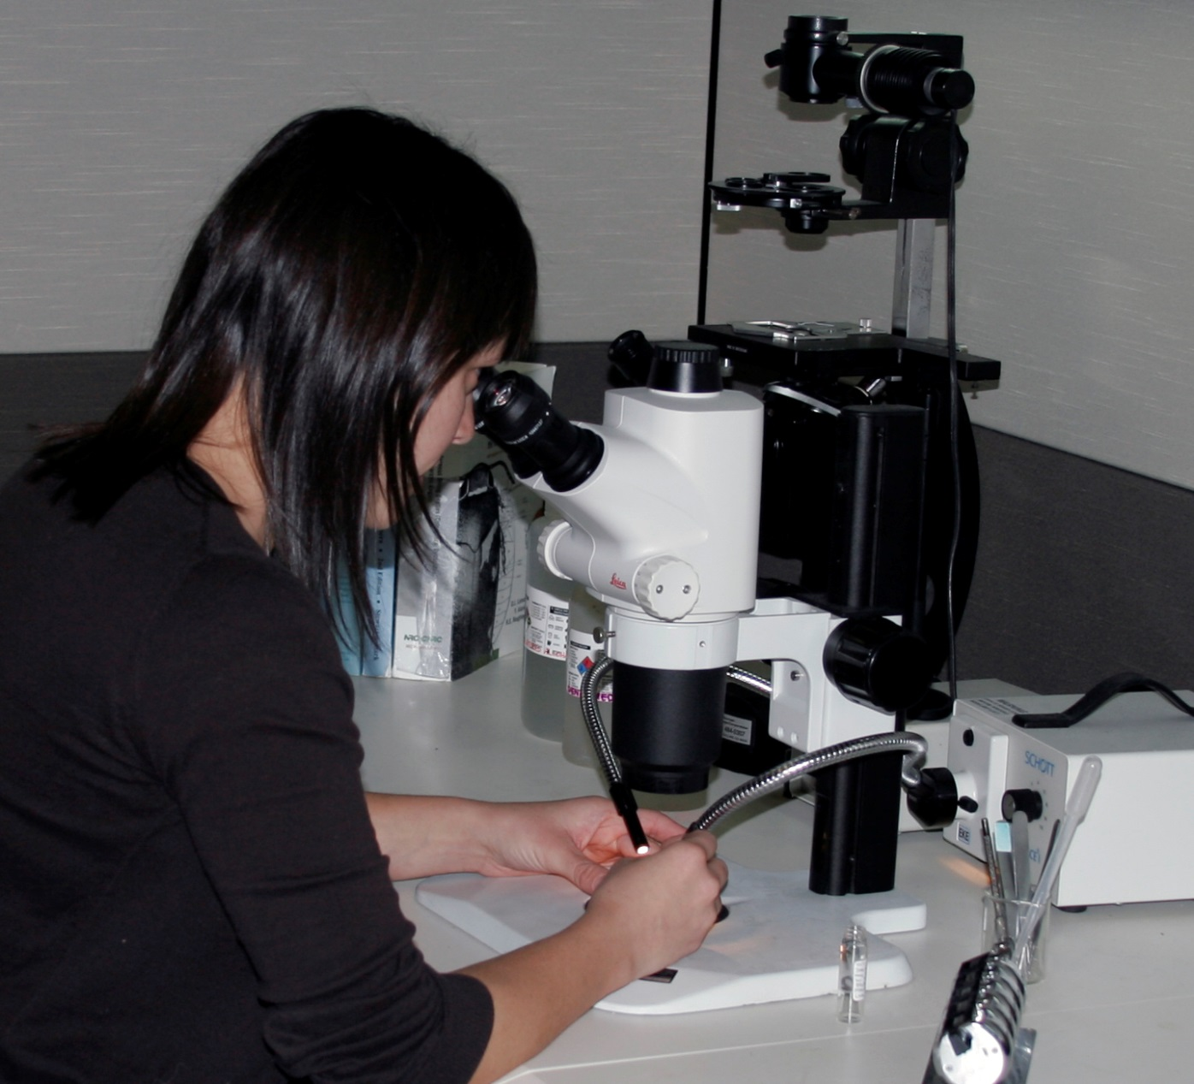
and then identify all those bugs
and
count
them.

Slide 11
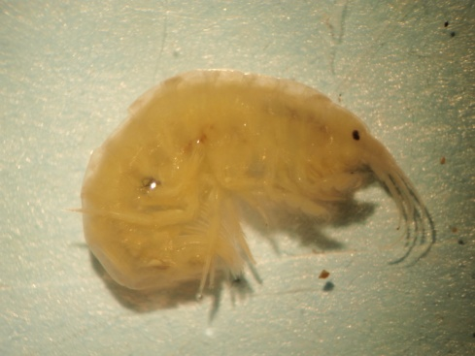
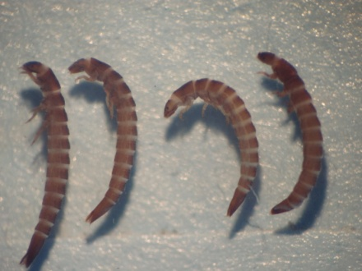
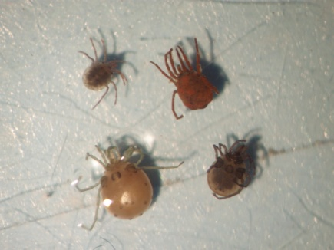
Invertebrate Taxonomy
Bugs from the samples are identified – usually to the genus or species level.
Quality assurance on IDs and counts – 95% is pass level
Report lists all of the taxa and their counts for each replicate at each site.

Slide 12
Final Bug Report
INSECTA
EPHEMEROPTERA
Baetis bicaudatus
Paraleptophlebia sp.
Timpanoga hecuba
ODONATA
Archilestes sp.
Enallagma sp.
PLECOPTERA
Cultus aestivalis
Doroneuria baumanni
Skwala paralella
Sweltsa sp.
COLEOPTERA
Agabus sp.
TRICHOPTERA
Arctopsyche grandis
Hesperophylax sp.
Hydropsyche sp.
Rhyacophila brunnea/vao
DIPTERA
Ceratopogoninae
Neoplasta sp.
Simulium sp.
CRUSTACEA
AMPHIPODA
Hyalella azteca cx.
MOLLUSCA
PELECYPODA
Dreissena polymorpha

Slide 13
Final Bug Report
Several metrics automatically calculated on a replicate basis (therefore, we can use them for statistical analysis)
Total density
Number of taxa
Number of EPT taxa
EPT Index
Ephemeroptera Abundance
Some metrics calculated based on composite of replicates
All above metrics
Shannon-Weaver Diversity Index
Additional metrics

Slide 14
Translating the Data
Our “Universal Translator” – takes bug names and translates them into ecological entities
BUGSWITH, GEI’s in-house, proprietary system in Excel for managing invertebrate data
Benthic Invert Taxa List
Data Entry/Report Production Worksheets
Taxon Characterization Worksheet
Metric Calculation Worksheet
List of Taxonomic Literature
Data can be used to calculate Colorado Multimetric Index (MMI)

Slide 15
Benthic Invert Taxa List - the “backbone” of the system
List of 12,337 invertebrate taxa (1 January 2014)
Started with <2,000 taxa, using Barbour et al. (1999)
Taxa added as we encounter checklists or taxonomic revisions
Total of 10,491 (85%) are insect taxa
Features:
Standard Taxonomic Effort
Taxonomic Serial Numbers
Tolerance Values
Species Traits
Geographic Distribution
Supported by >670 pieces of literature (books, articles, etc.)

Slide 16
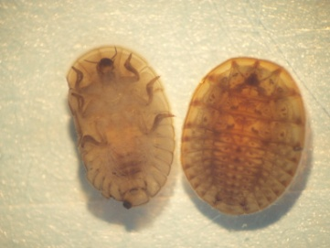
Standard Taxonomic Effort
Indicates standard taxonomic level to stop at when identifying invertebrates
Usually genus level
Some species level
Sometimes family or subfamily level
Indicates appropriate literature to use
Identifies monospecific genera at Nearctic, regional, or state levels
Identifies synonyms, so proper name can be used
Includes some distributional information

Slide 17
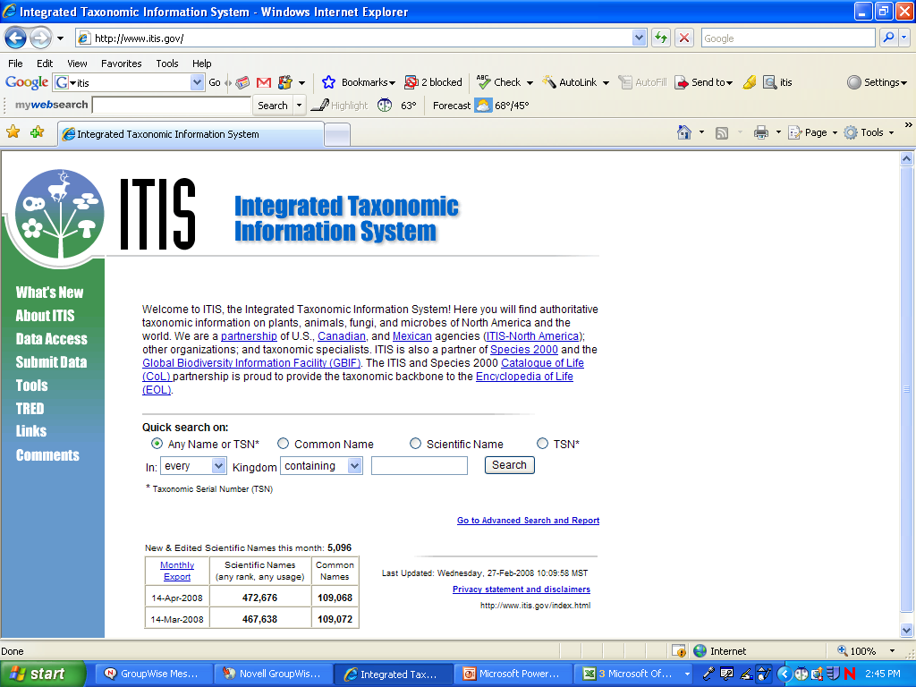
Taxonomic Serial Numbers
TSNs are unique numbers assigned to each taxon
U.S. Department of Agriculture
Integrated Taxonomic Information System
Standardized identification system

Slide 18
Tolerance Values
Based on Saprobien System of early 1900s
Chutter (1972) first to assign tolerance values
Hilsenhoff Biotic Index (HBI - 1977)
Wisconsin
Designed to identify organic pollution
Values based mostly on professional experience
Some at Family level, but generally use genus and species level TVs

Slide 19
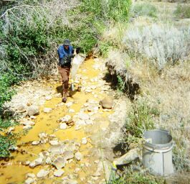
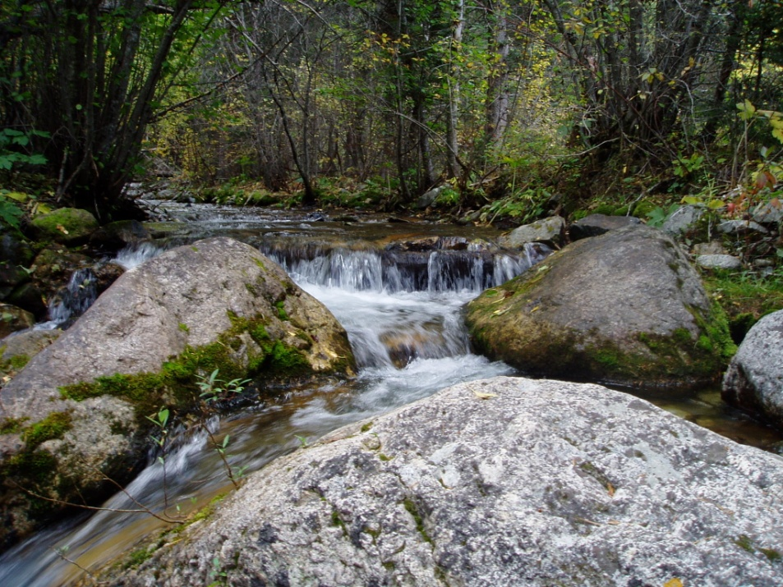
Tolerance Values
0 – 3
Intolerant
4 – 6
Moderate
7 – 10
Tolerant
0 - Pristine
10 - Degraded
TV

Slide 20
Hilsenhoff Biotic Index
HBI = Σ (density * TV) / Total Density
Taxon | Density | TV | Density x TV
Baetis tricaudatus | 100 | 4 | 400
Rhyacophila sp. | 25 | 0 | 0
Chironomus sp. | 50 | 8 | 400
Total Density | 175 |  | Σ TV = 800
HBI = 800/175 = 4.57

